Slide 1


Pokémon Combat Prediction
19 Fall DS502 Final Project
Members: Zhiyi Huang, Mengzhi Cao, Yi Yang, Chuchen Dai, Lei Guo

Slide 2

Project overview

Slide 3
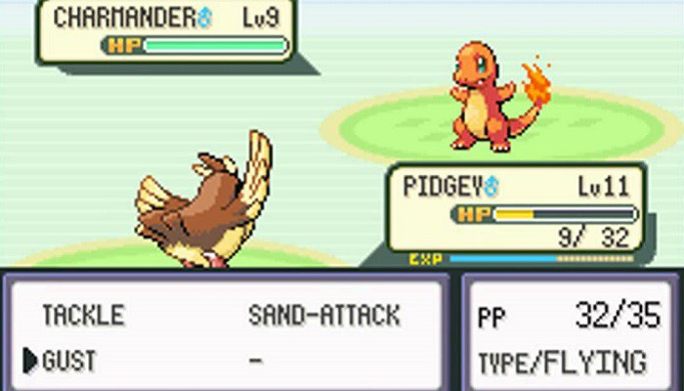
Project Description
To develop a Machine Learning model able to predict the result of future pokemon combats.

Slide 4
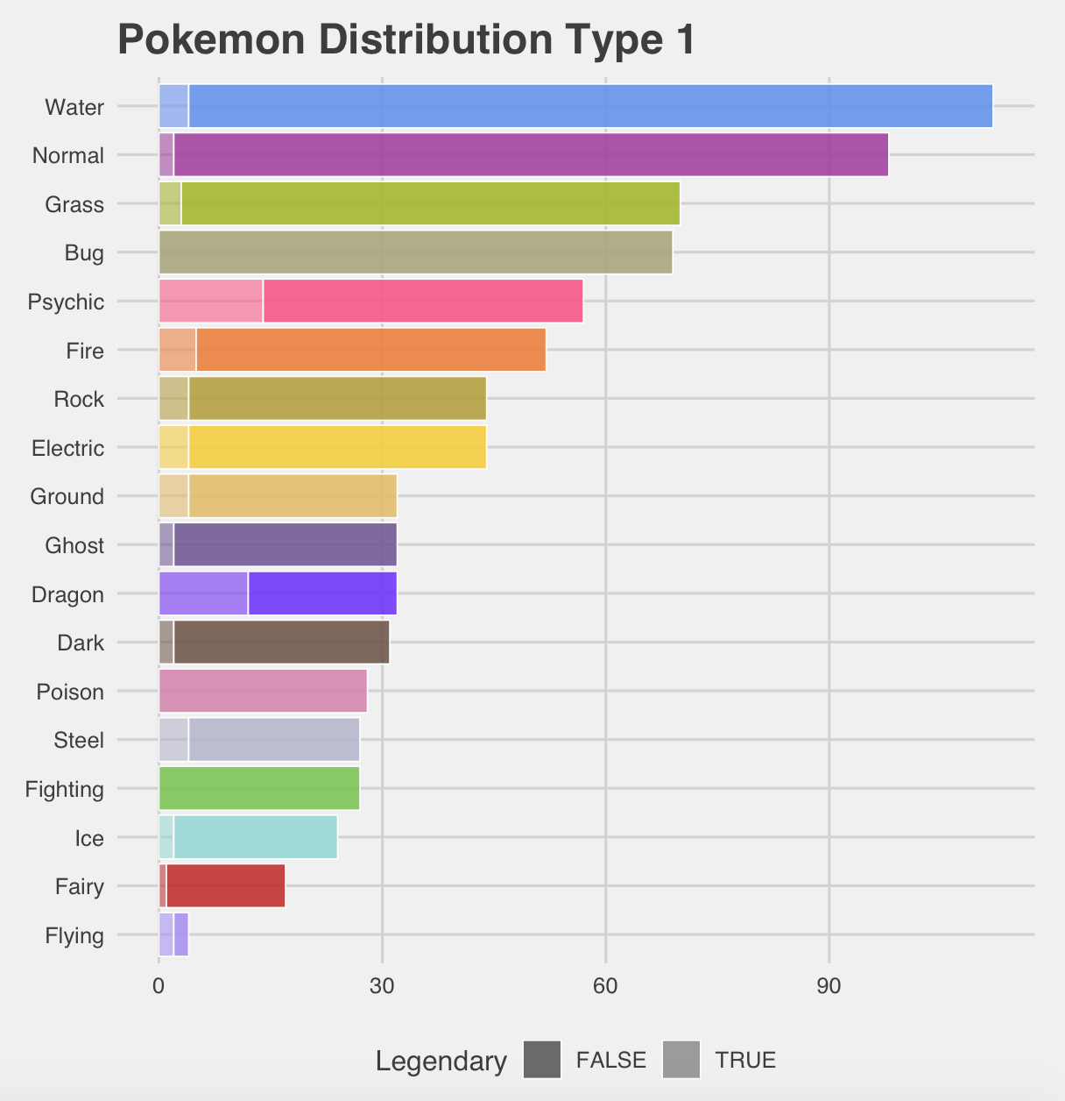
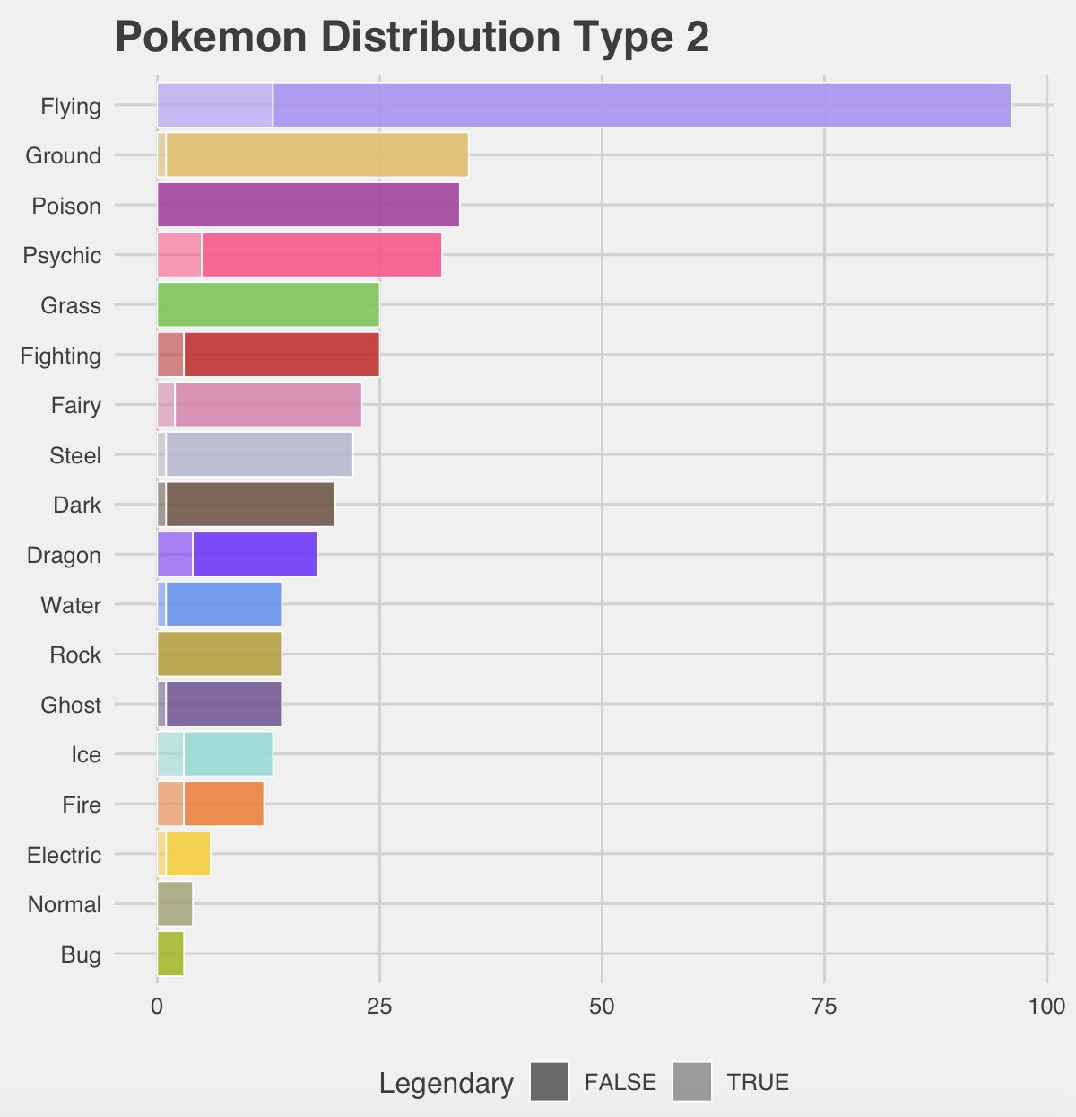
Data Overview-Pokemon Distribution Overview
Notes:
For the overview of the whole Pokémon data set, we calculate the total number of Pokémon in terms of type 1 (Figure 1.2.1) and type 2 (Figure 1.2.2). even though the whole type 2 data is balanced, not all the Pokémons have the second Type. Therefore, for the rest of the project, we will focus on the Type 1 data.

Slide 5
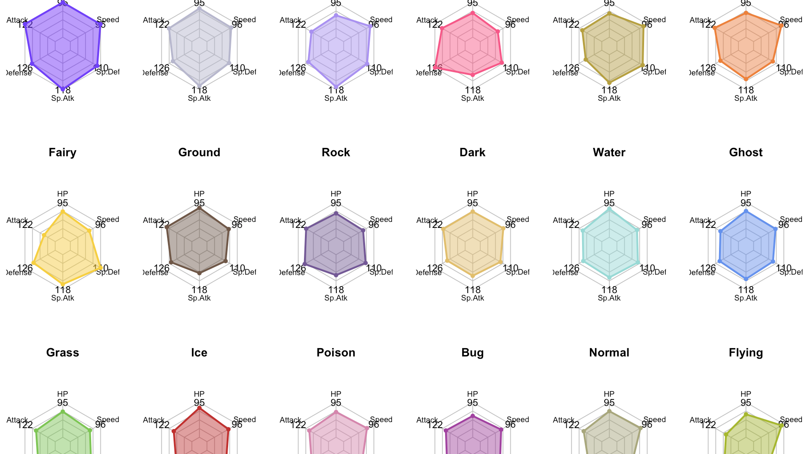
Data Overview-Pokemon Characteristics
Notes:
For the detailed learning about the characteristics of the Pokémon, which means the HP, Attack, etc. We choose the Radar Chart, which is helpful to see the characteristics distribution for all types of Pokémon.

Slide 6
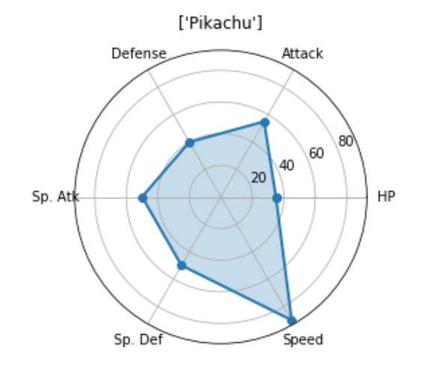

Data Overview-Pikachu Example

Slide 7
Feature Engineering
Notes:
I’m going to introduce the feature engineering of our project.

Slide 8


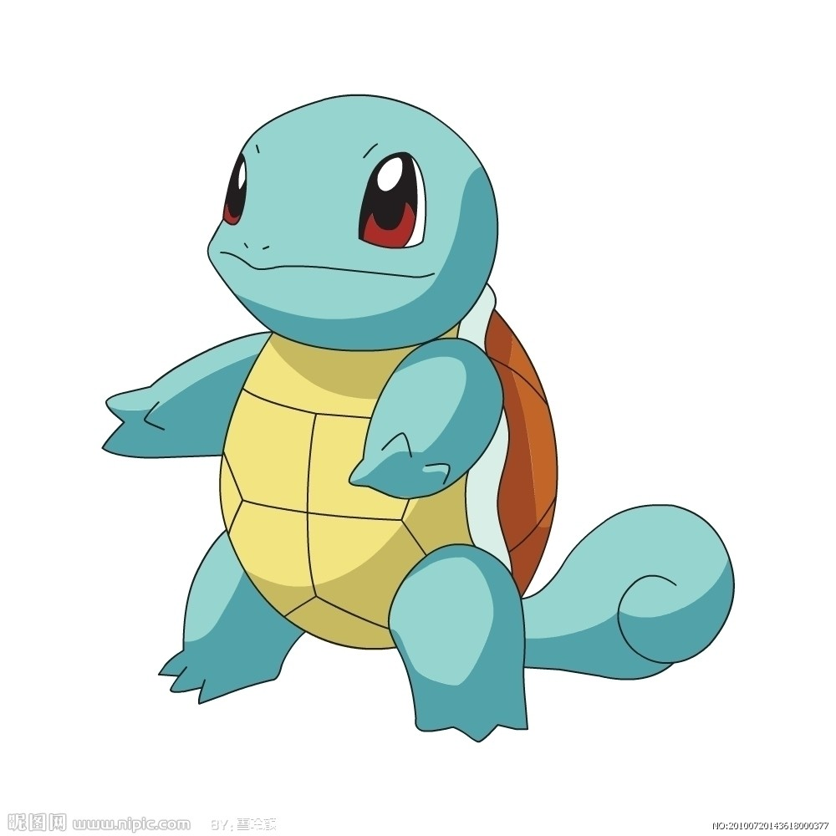
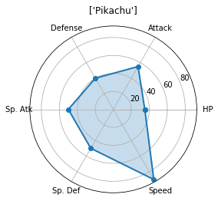
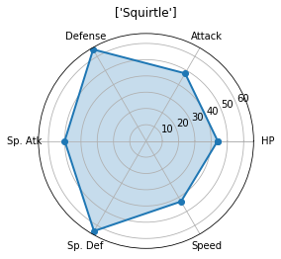


Notes:
Here we use pikachu and squirtle as an example. If they battle with each other. Let’s see what kind of features do we have. Firstly there are six different kinds of properties of each pokemon. They are HP, Attack, Defense, SP.Atk, SP Def and speed. Each pokemon owns two or one type. For example pikachu is a electric-type pokemon, and squirtle is a water-type pokemon. So, if they fight each other, squirtle will suffer double damage, however pikachu only take half damge.

Slide 9
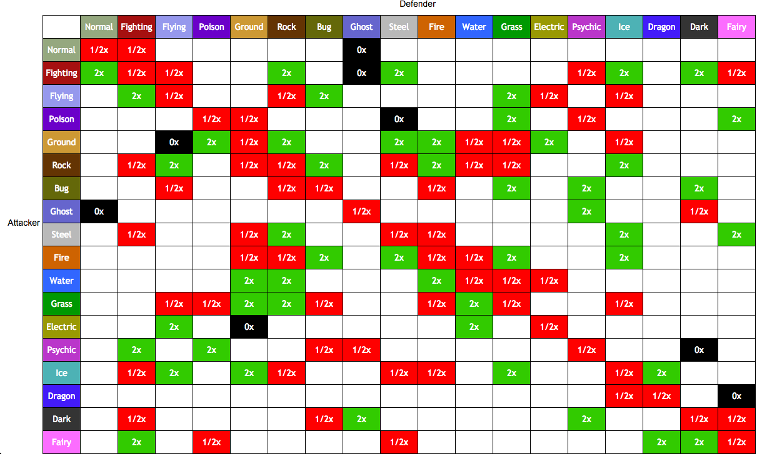
Notes:
This result comes from here, a type-chart. There are total 18 different types in pokemon. This type will determine how much magnification of attack they will cause

Slide 10

HPsub
SATdiv SDF
Speed
Modifier
ATdivDF
Notes:
Then there is a damage equation. You can see the damage is based on the pokemon different properties.

Slide 11
Models
Notes:
ttaddas

Slide 12
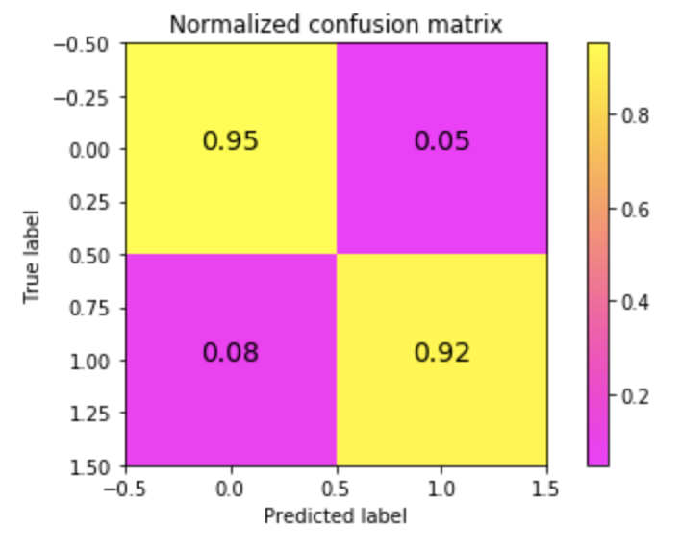
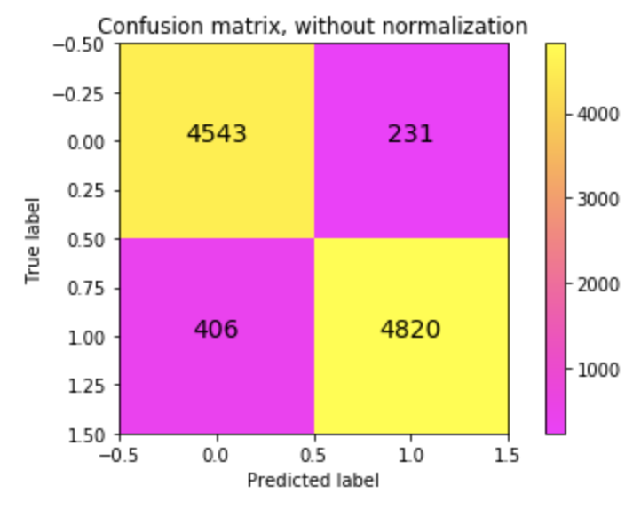
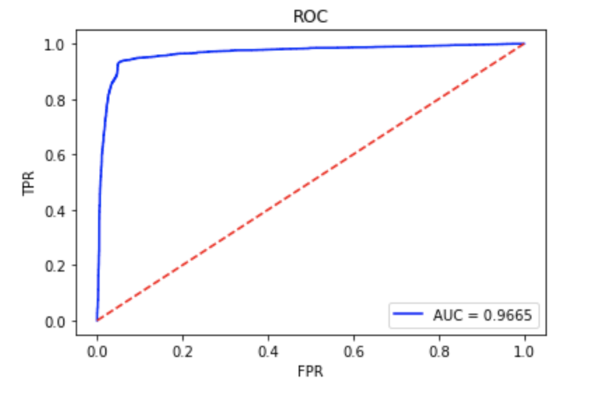
Logistic regression
With multinomial loss:
Time consumed: 0:00:05.891594
AUC: 0.9664
F1 score: 0.9363
With binary loss:
Time consumed: 0:00:01.551357
AUC: 0.9664
F1 score: 0.9361

Slide 13
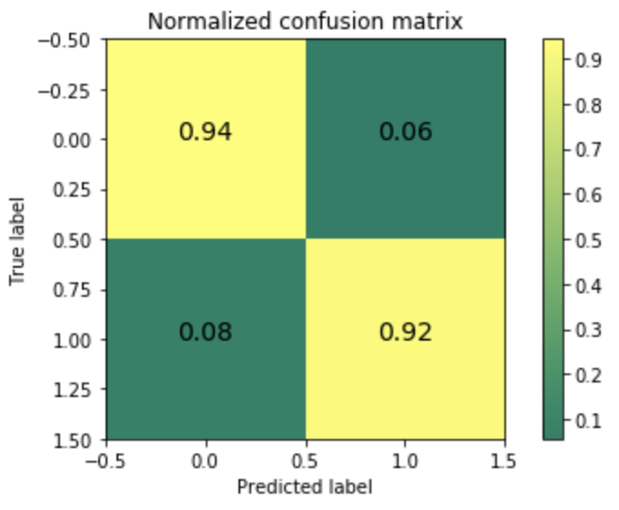
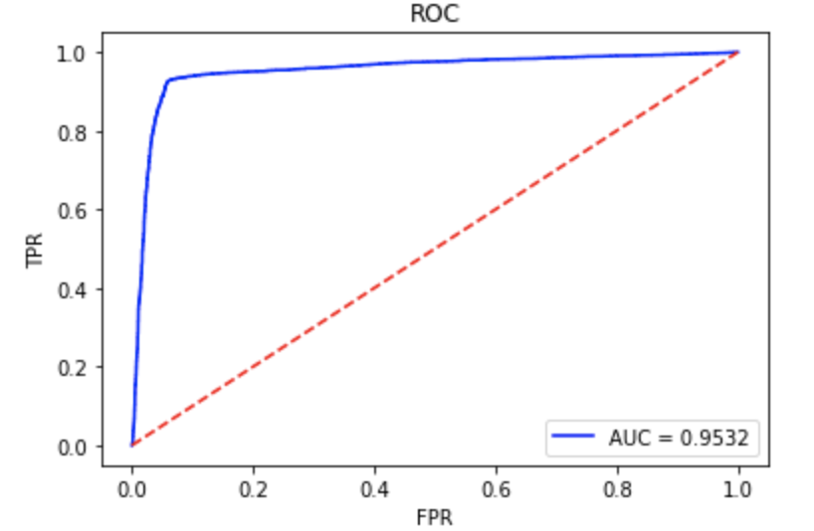
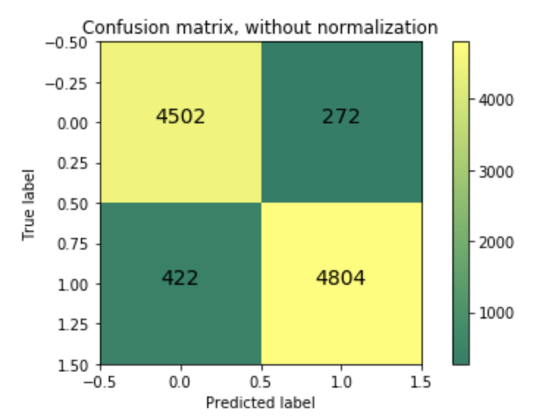
Naive Bayes
Time consumed: 0:00:00.013714
AUC: 0.9531
F1 score: 0.9306

Slide 14
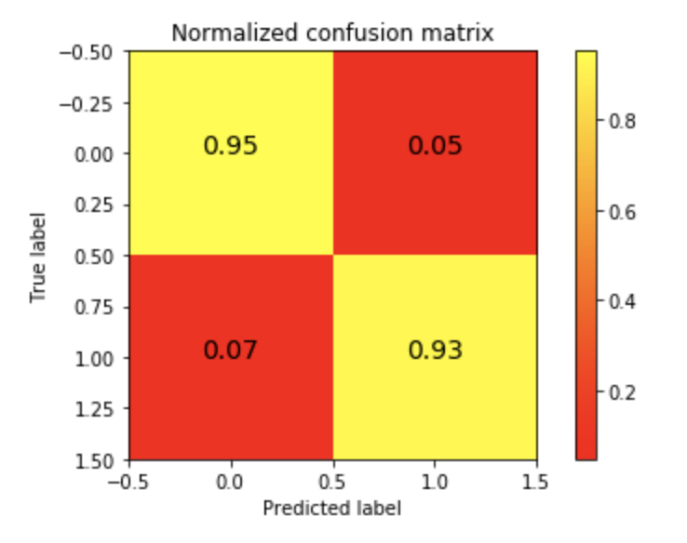
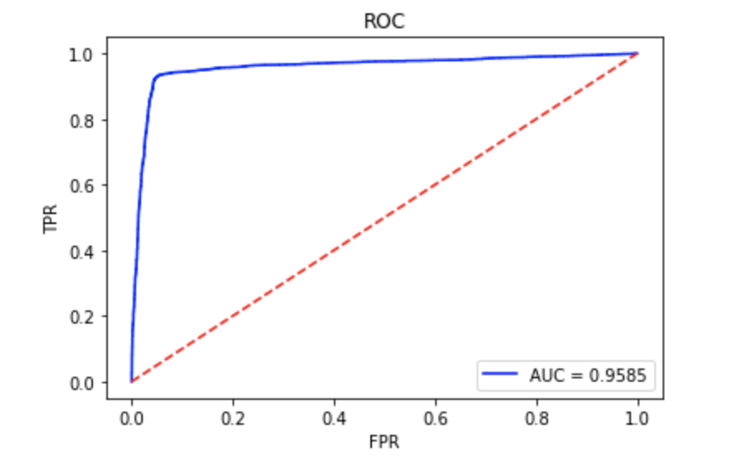
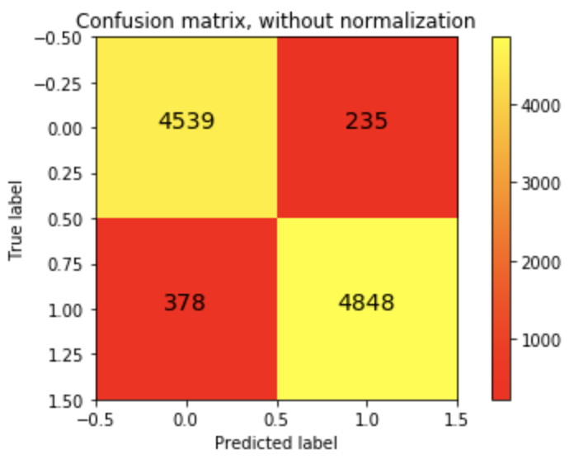
Support Vector Machine
Time consumed: 0:03:14.221710
AUC: 0.9585
F1 score: 0.9387

Slide 15
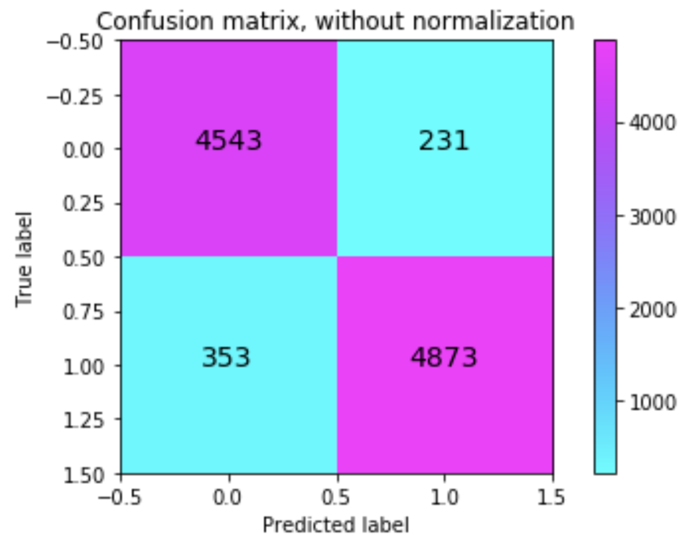
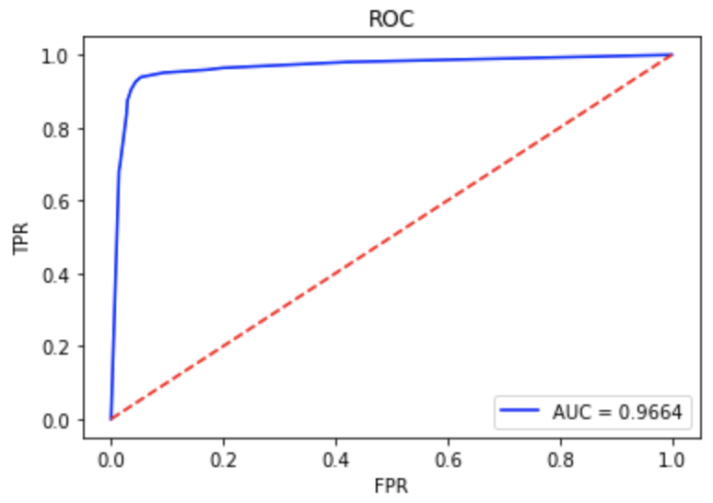
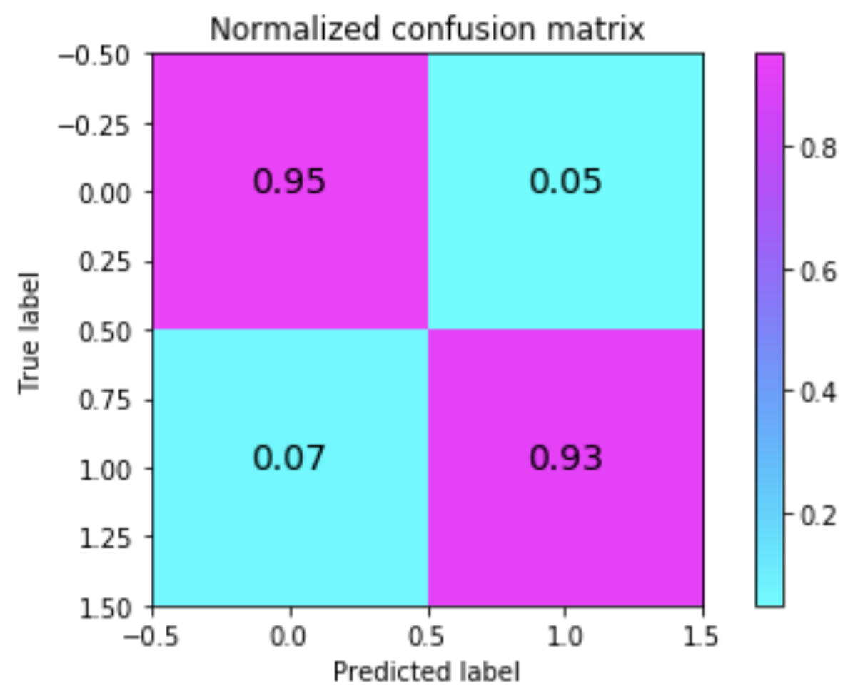
Decision Tree
Time consumed: 0:00:00.070774
AUC: 0.9664
F1 score: 0.9416

Slide 16
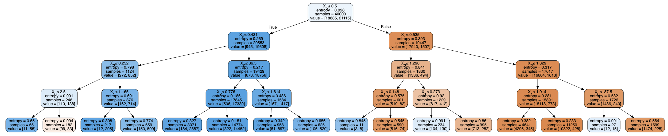
Decision Tree

Slide 17
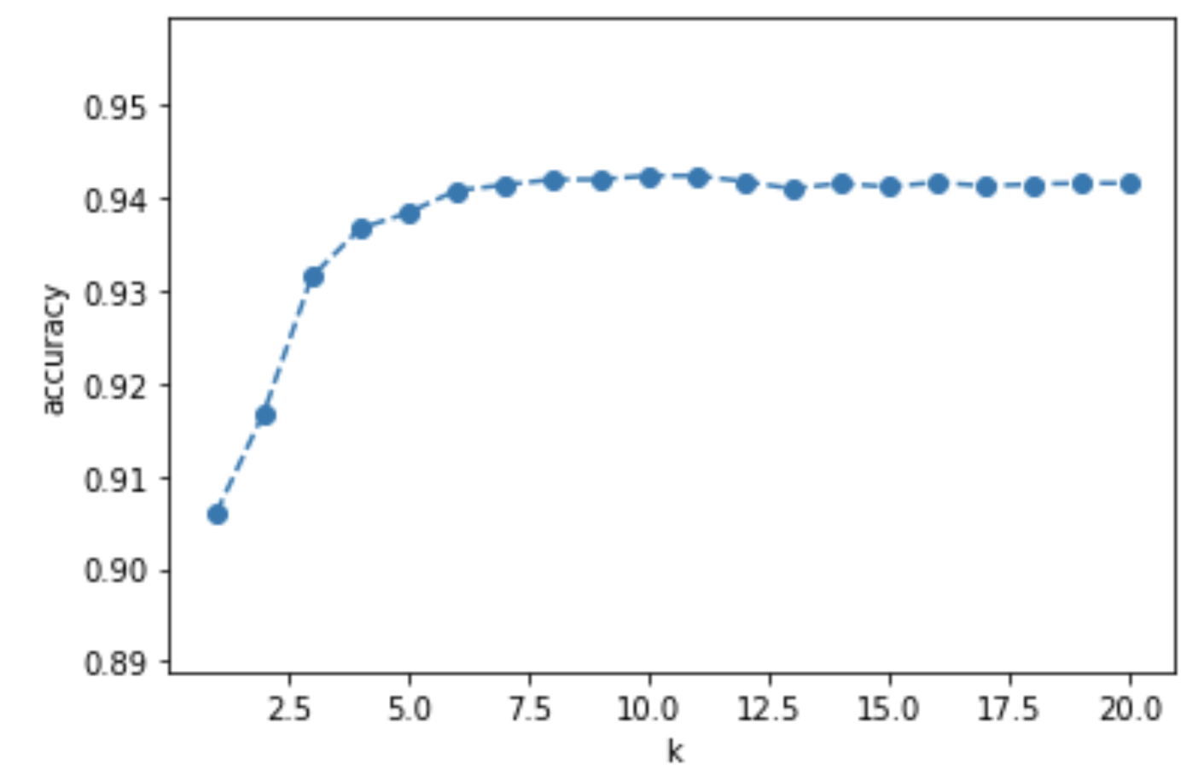
KNN
Figure: the experiment of KNN classifier on k
best k=10, F1-score=0.9424

Slide 18
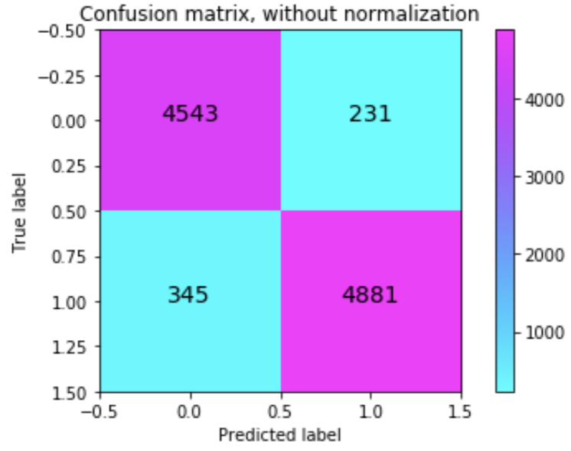
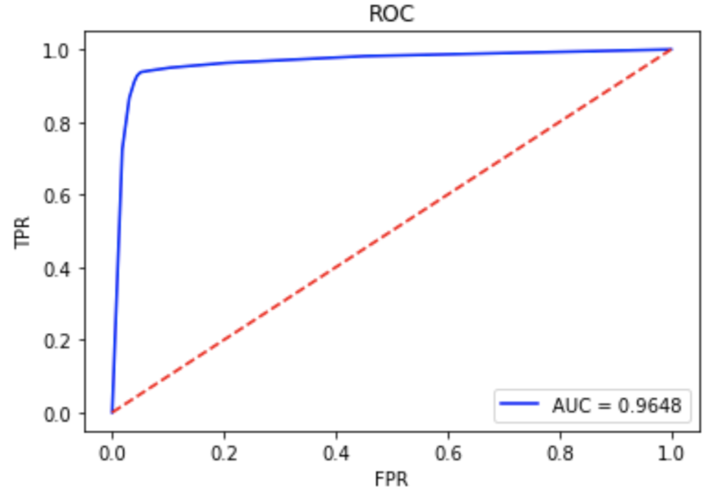
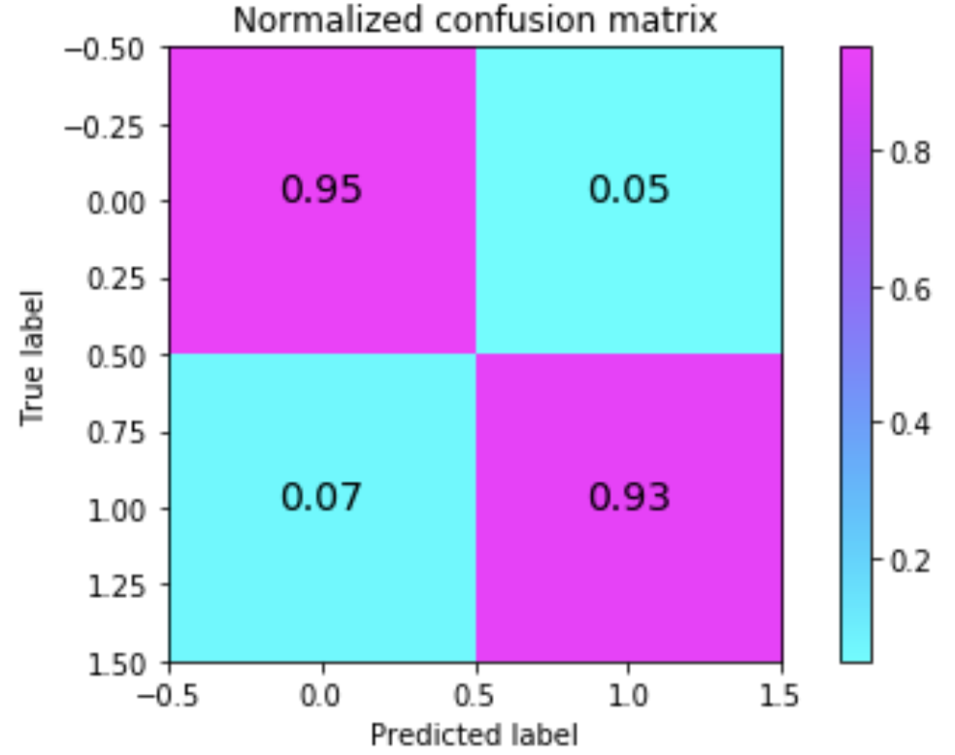
KNN
Time consumed: 0:00:00.409310
AUC: 0.9648
F1 score: 0.9424

Slide 19
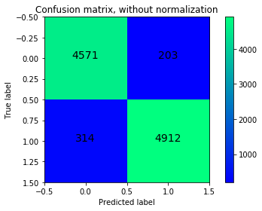
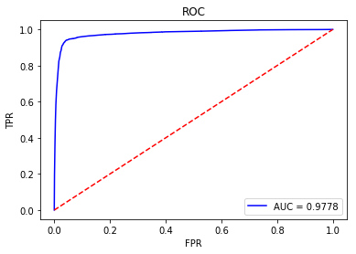
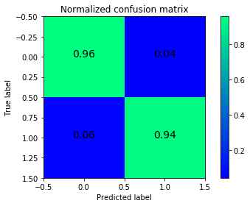
Random Forest
Time consumed: 0:00:03.975817
AUC: 0.9778
F1 score: 0.9483

Slide 20
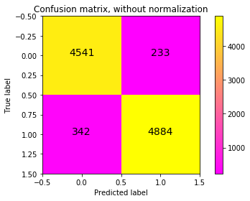
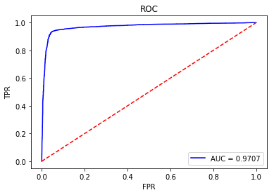
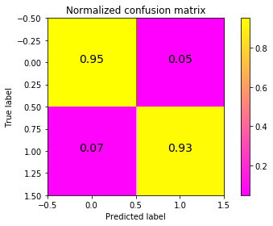
AdaBoost (Adaptive Boosting)
Time consumed: 0:00:02.311698
AUC: 0.9707
F1 score: 0.9425

Slide 21
Summary

Slide 22
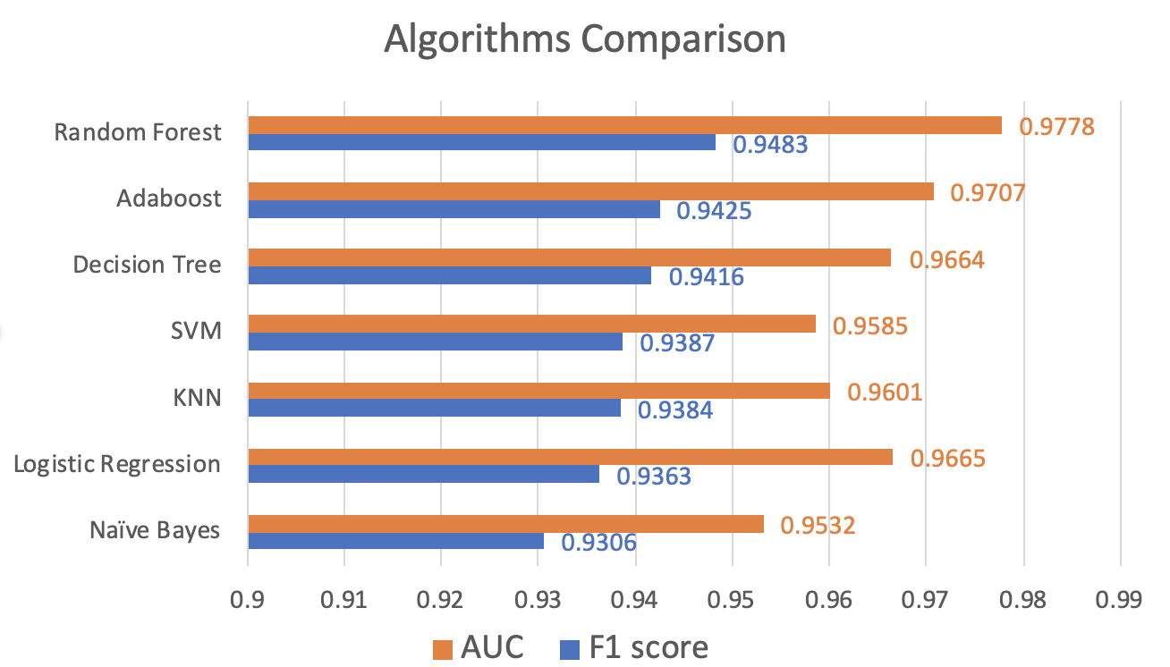
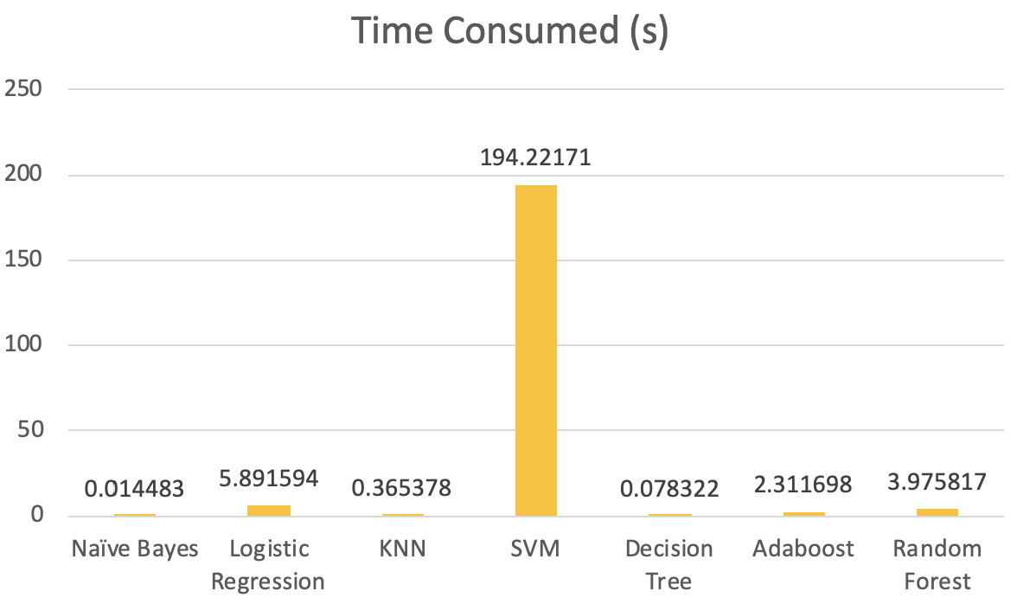
Summary of the results
Best approach: Random Forest

Slide 23
Summary of the results
Best approach: Random Forest
2nd good approach: Adaboost, Decision Tree
Reasons:
Tree-type algorithms good at processing mixed formats: discrete data + continuous data.
Ensemble methods (Bagging and Boosting ) can handle large datasets with higher dimensionality well.
It is generally believed that Random Forest mainly reduce variance and AdaBoost mainly reduce bias. So Random Forest is good to deal with overfitting problem, but AdaBoost not.
Random Forest is easier to implement than AdaBoost. AdaBoost: good at clean data; Random Forest: good at more complex data.

Slide 24
Thank you!
Any Questions?

